Slide 1
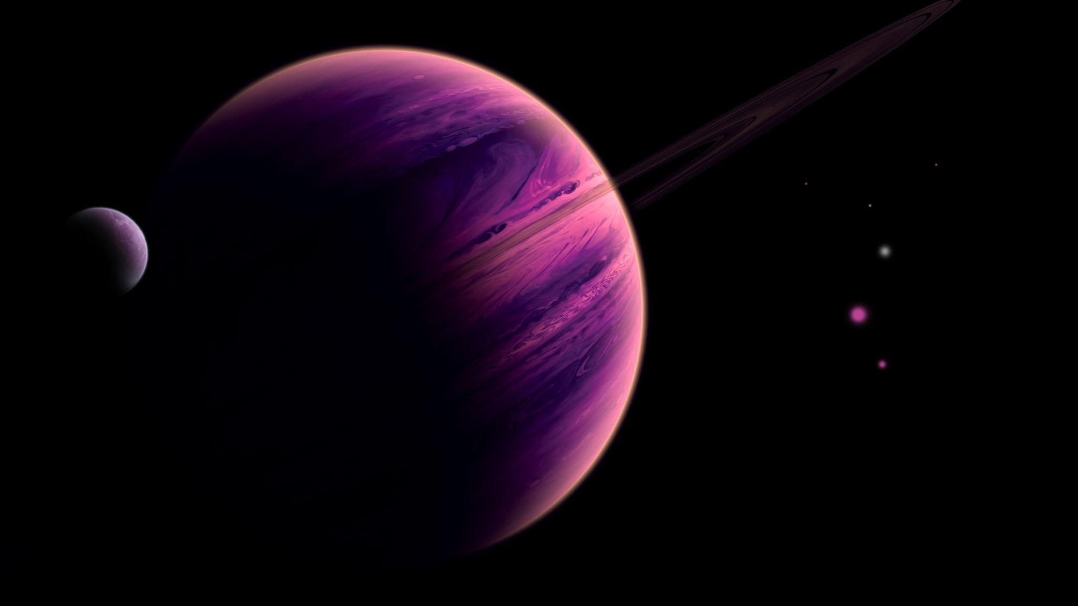
Exoplanet Detection
Hunt for alien worlds using Machine Learning
Abhishek Aggarwal (102003389)
Arunima Singh (102183034)

Slide 2
This project aims to use Machine Learning Techniques to predict Exoplanets using Transit Method
Transit Method
A Digital-camera-like technology is used to detect and measure tiny intensity dips in a star’s brightness as the start is partially obscured by the planet.

Slide 3
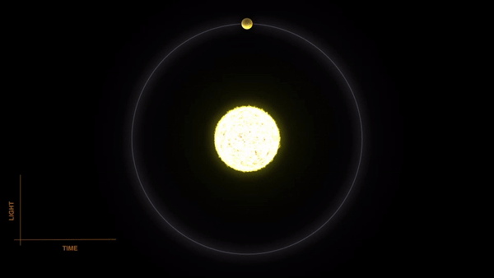
Transit Method

Slide 4
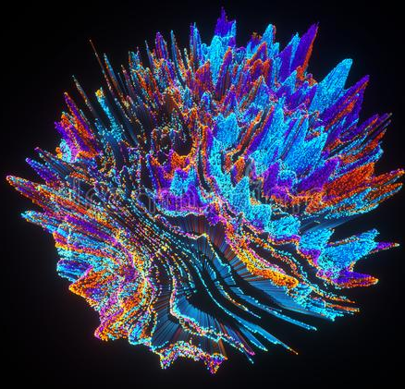


Acquiring The Dataset
The data is fetched from publicly available NASA’s API
Dataset is based on Kepler Space Mission starlight intensity time series data.
It contains data of 5087 potential exoplanet systems it has taken observations on.

Slide 5
Important Preprocessing Tasks
Label Encoding of target variable to convert it into binary values.
PCA (Principal Component Analysis) to reduce the ‘curse of dimensionality’ in such dataset with a large number of features.
Data Normalization to change the values of numerical columns to a common scale, without distorting differences in range of values.
Laplace-Gaussian Filter because averages of samples of observations of random variables independently drawn from the same distribution converge in distribution to the normal.
SMOTE Resampling Method to create synthetic samples of minority class equal to majority class.

Slide 6
Machine Learning Models used so far in this project
Support Vector Machine
Random Forest Classifier
K Nearest Neighbours
Logistic Regression
Decision Tree Algorithm
Bernoulli Naive Bayes

Slide 7
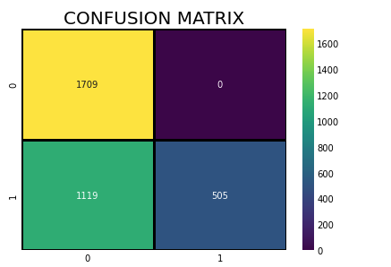
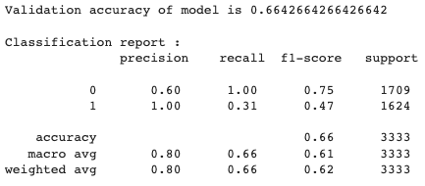
Support Vector Machines

Slide 8
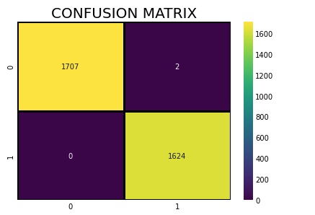
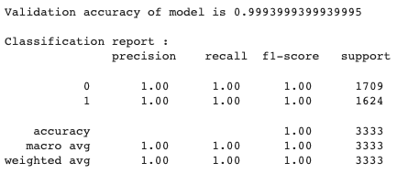
Random Forest Classifier

Slide 9
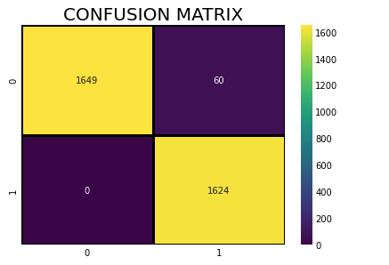
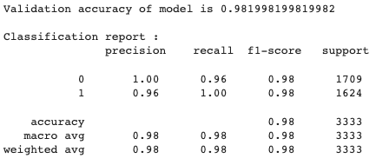
K Nearest Neighbours

Slide 10
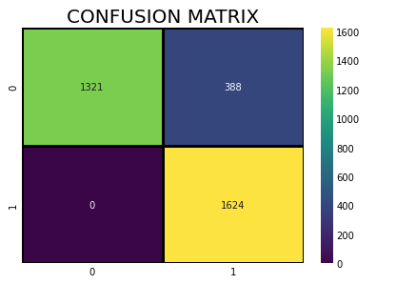
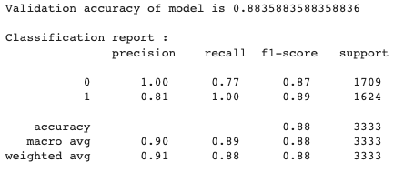
Logistic Regression

Slide 11
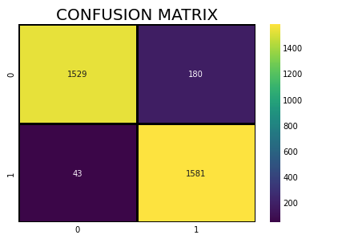
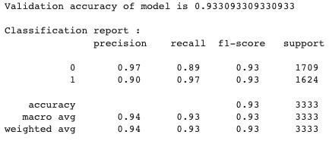
Decision Tree Algorithm

Slide 12
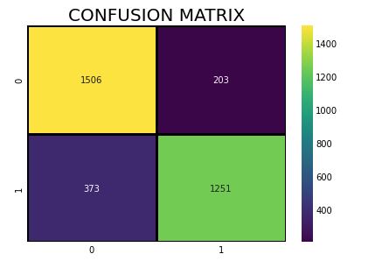
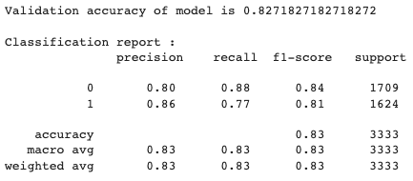
Bernoulli Naive Bayes

Slide 13
Evaluation Results (Accuracy Score)
Support Vector Machine - 0.6642664266426642 i.e. 66.426%
Random Forest Classifier - 0.9993999399939995 i.e. 99.939%
K Nearest Neighbours - 0.981998199819982 i.e. 98.199%
Logistic Regression - 0.8835883588358836 i.e. 88.358%
Decision Tree Algorithm - 0.933093309330933 i.e. 93.309%
Bernoulli Naive Bayes - 0.8271827182718272 i.e. 82.718%
So far we had achieved highest accuracy score of 0.9993999399939995 using Random Forest Classifier. Other models that achieved well were K-Nearest Neighbours and Decision tree algorithm.

Slide 14
Conclusions:
In this project we proposed exoplanet planet detection methods based on classical machine learning. Our method consists of extracting time series features from light curves which are then used as input to our machine learning model.
In our attempt, the preprocessing and models we used achieved handsomely accurate results.
Project Repo Link: https://github.com/abhishek-x/exoplanet-detection-using-machine-learning/blob/main/Exoplanet%20Detection.ipynb

Slide 15

Future Improvements
Implement various other resampling techniques to address class imbalance problems.
Tuning hyperparameters of algorithms to achieve greater accuracy scores.
Test the use of Neural Networks to make more accurate predictions.

